Slide 1
dashboardify
Irmantas Ivanauskas, Žygimantas Žilevičius, Martynas Kadiša

Slide 2
About us

Slide 3
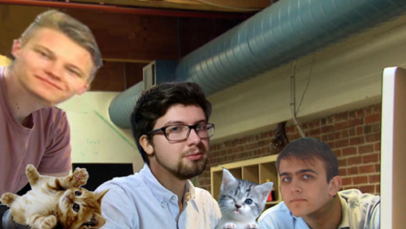
THE FELLOWSHIP OF THE CODE
Žygimantas
Irmantas
Martynas
Kittens

Slide 4
Working in a team

Slide 5
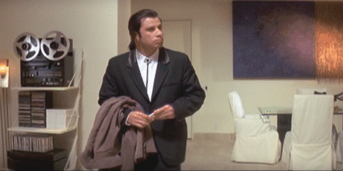
Before

Slide 6

Before
Uncharted lands with loads of tools and frameworks

Slide 7
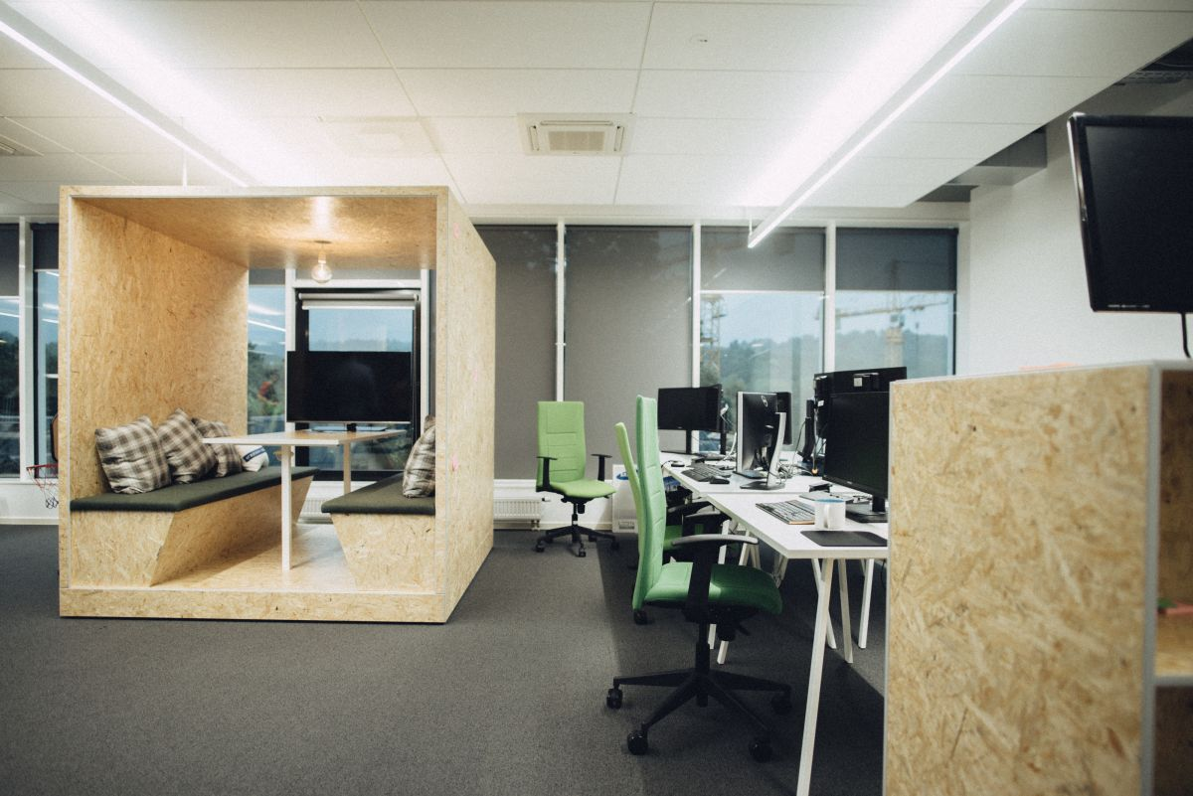
Before
New workplace

Slide 8
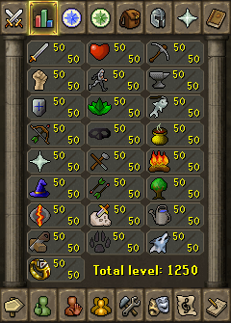
Before
New people with different skillsets

Slide 9
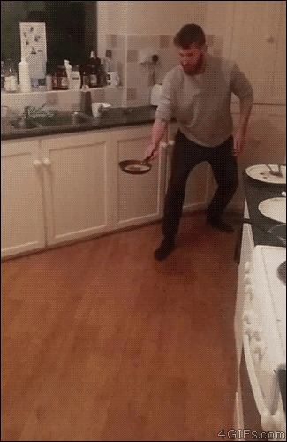
aFTER

Slide 10
aFTER
Familiarity with tools and frameworks

Slide 11
aFTER
Everyday fun activities at work

Slide 12
aFTER
Utilizing each other’s specialties

Slide 13
the project

Slide 14

IDEA
Who is this for?
For users who are searching for an easy to use web scraping tool
What does it do?
Tracking content changes in a website
Dashboardify

Slide 15
tIMELINE

Slide 16
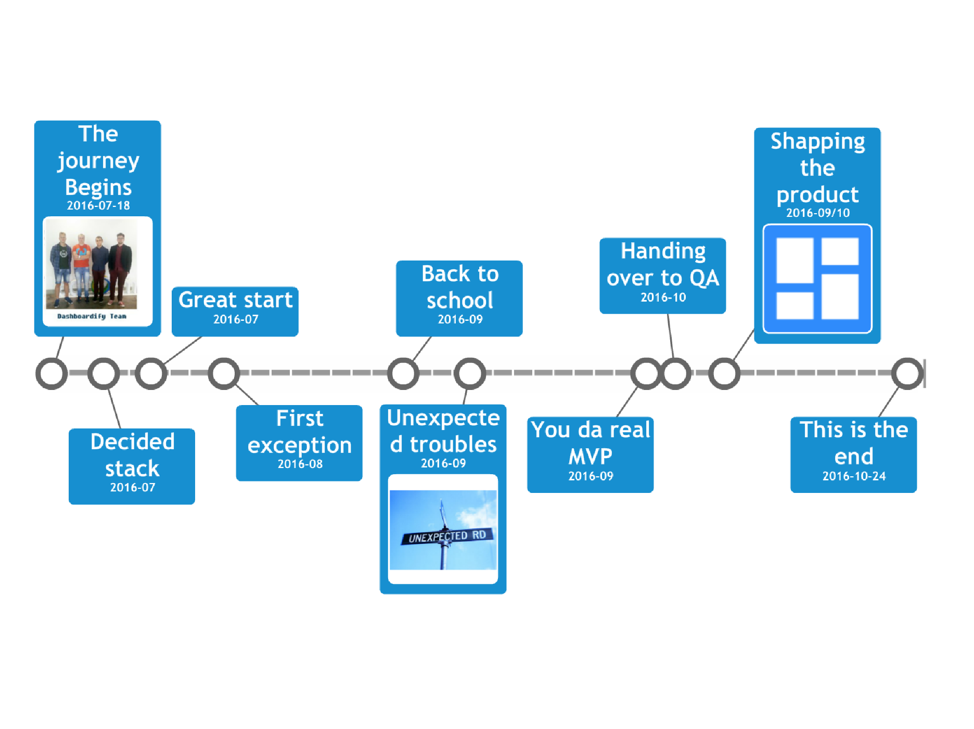

Slide 17
aRCHITECTURE

Slide 18
First attempt

Slide 19
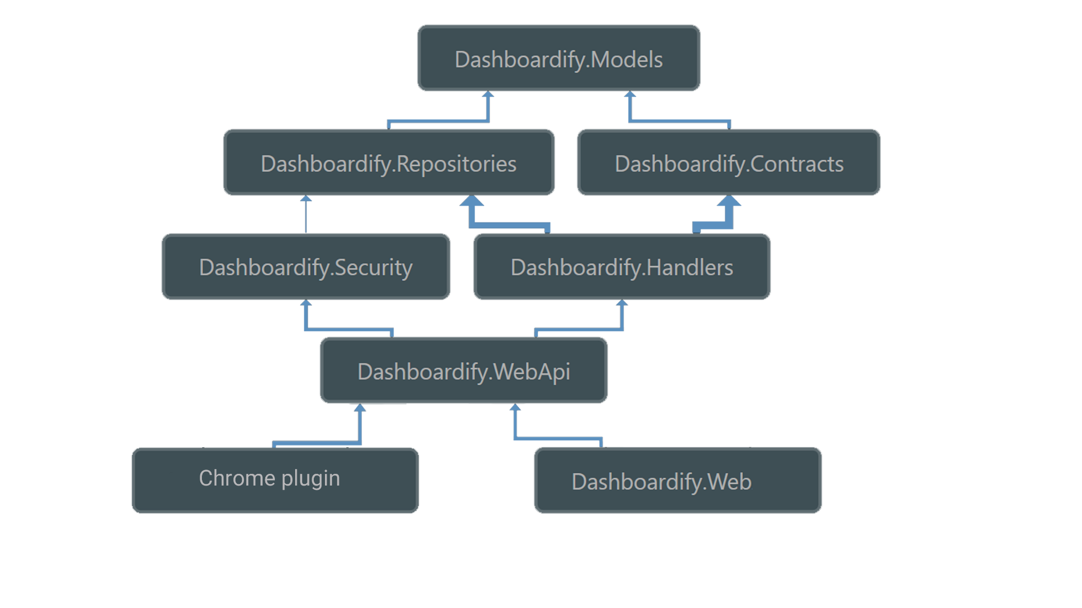
Final

Slide 20
tECHNOLOGIES

Slide 21
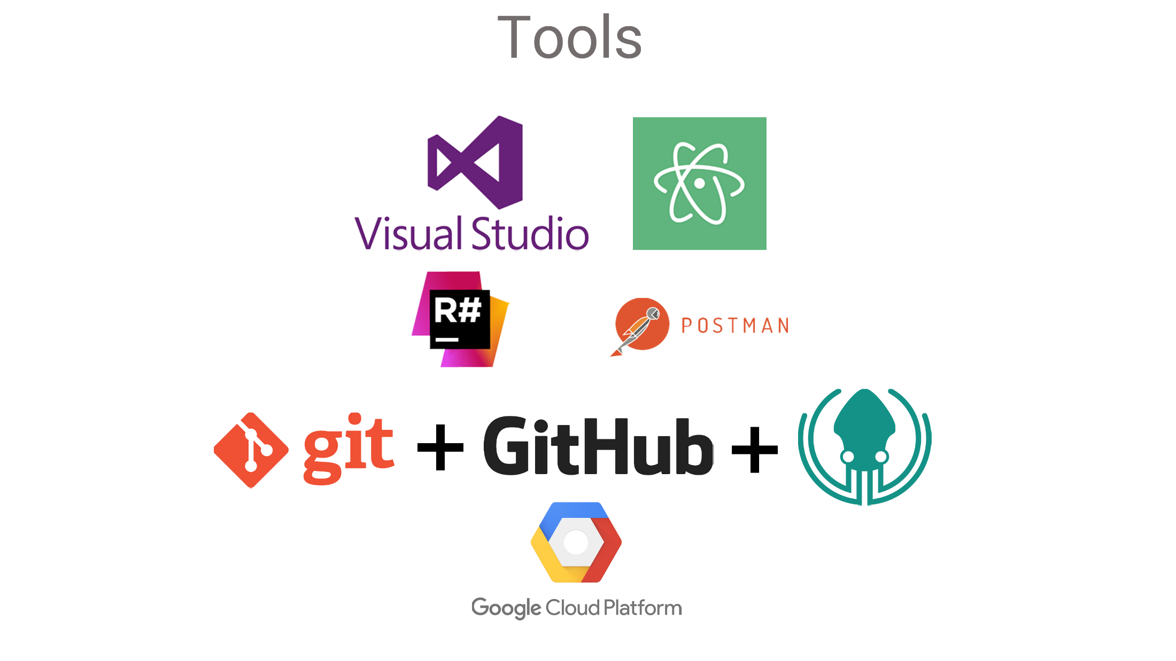

Slide 22

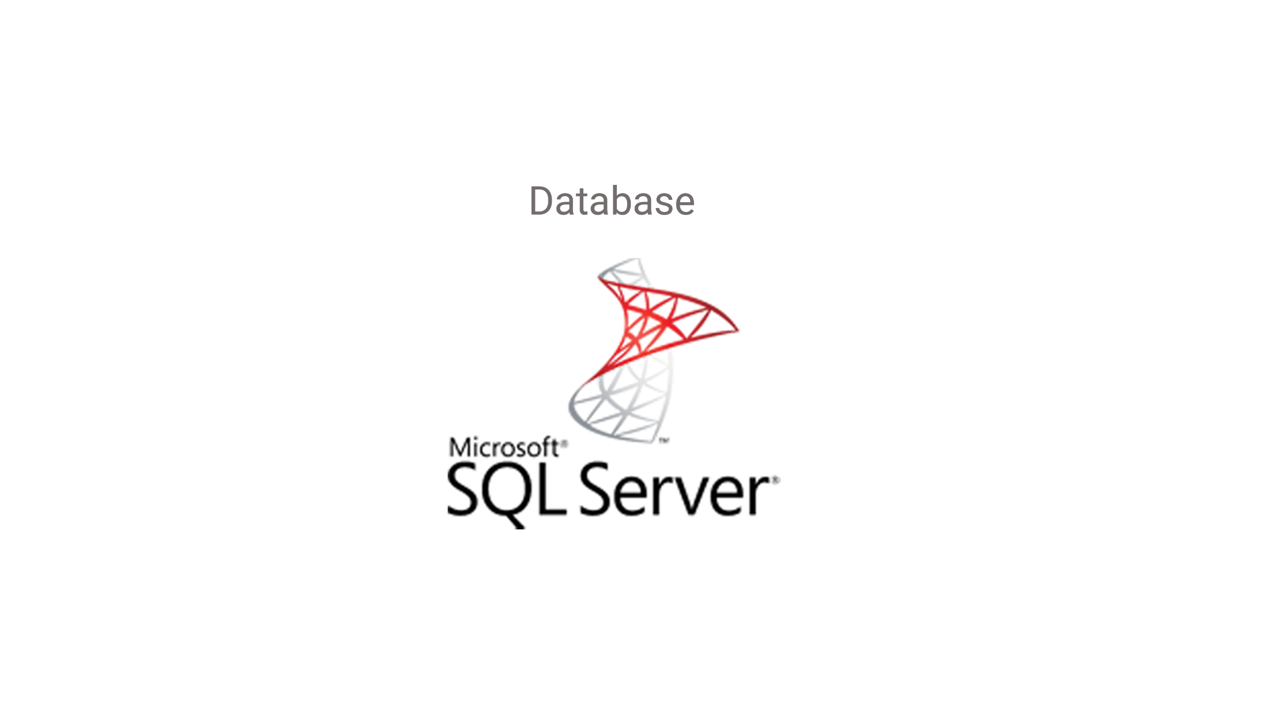

Slide 23
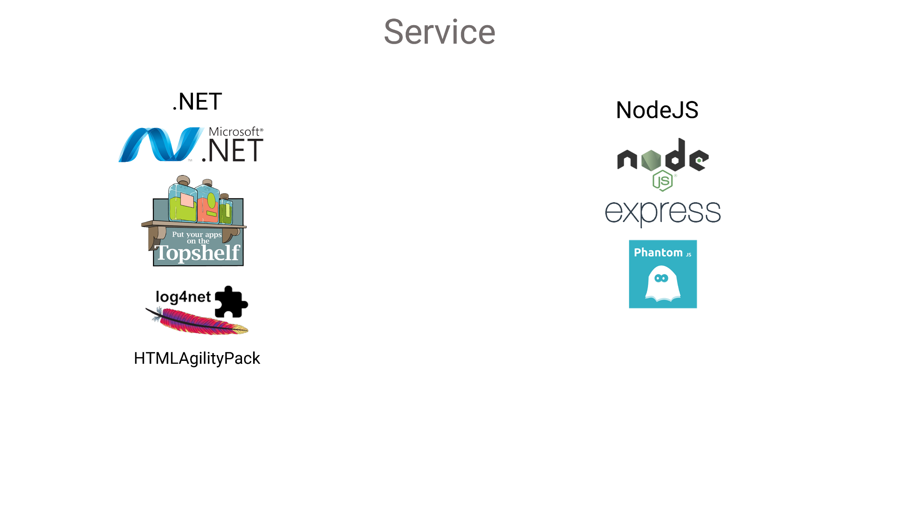

Slide 24
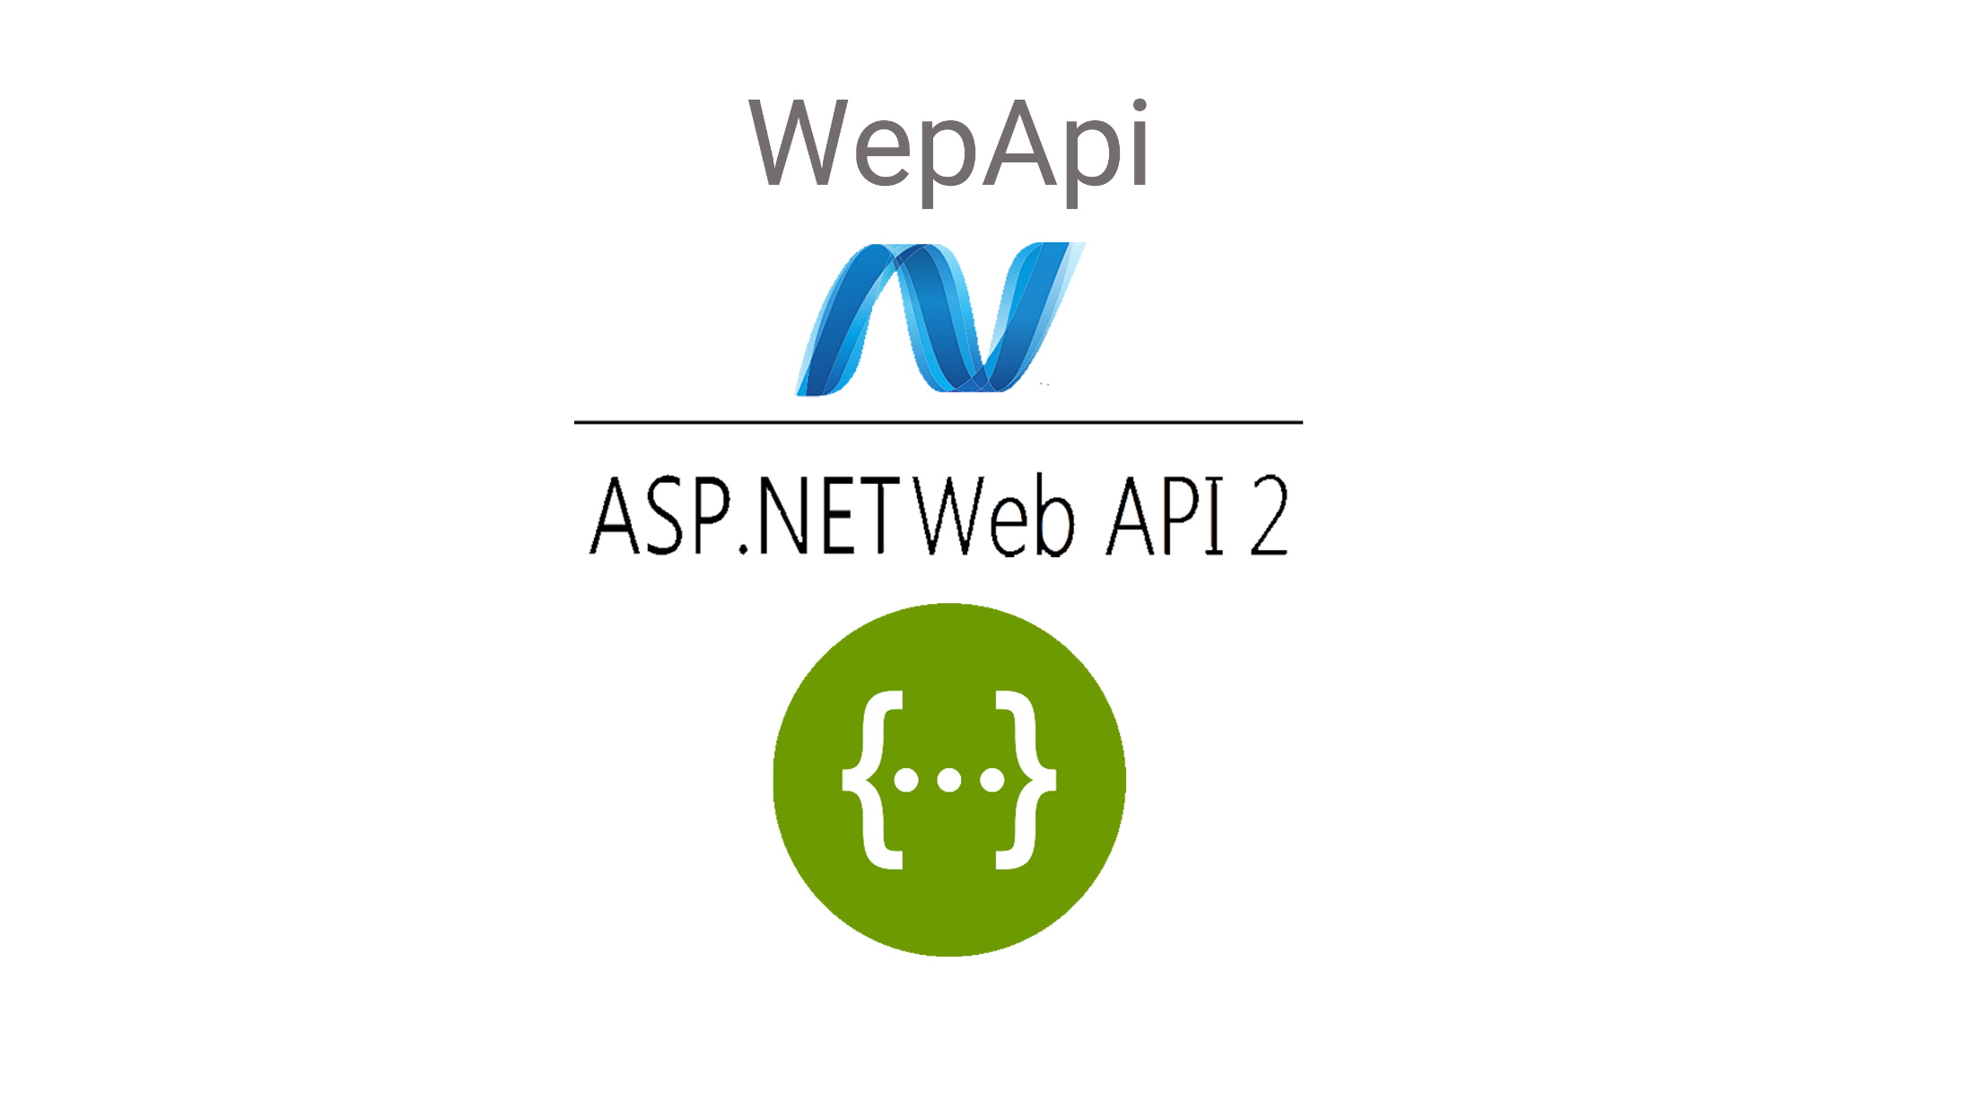

Slide 25
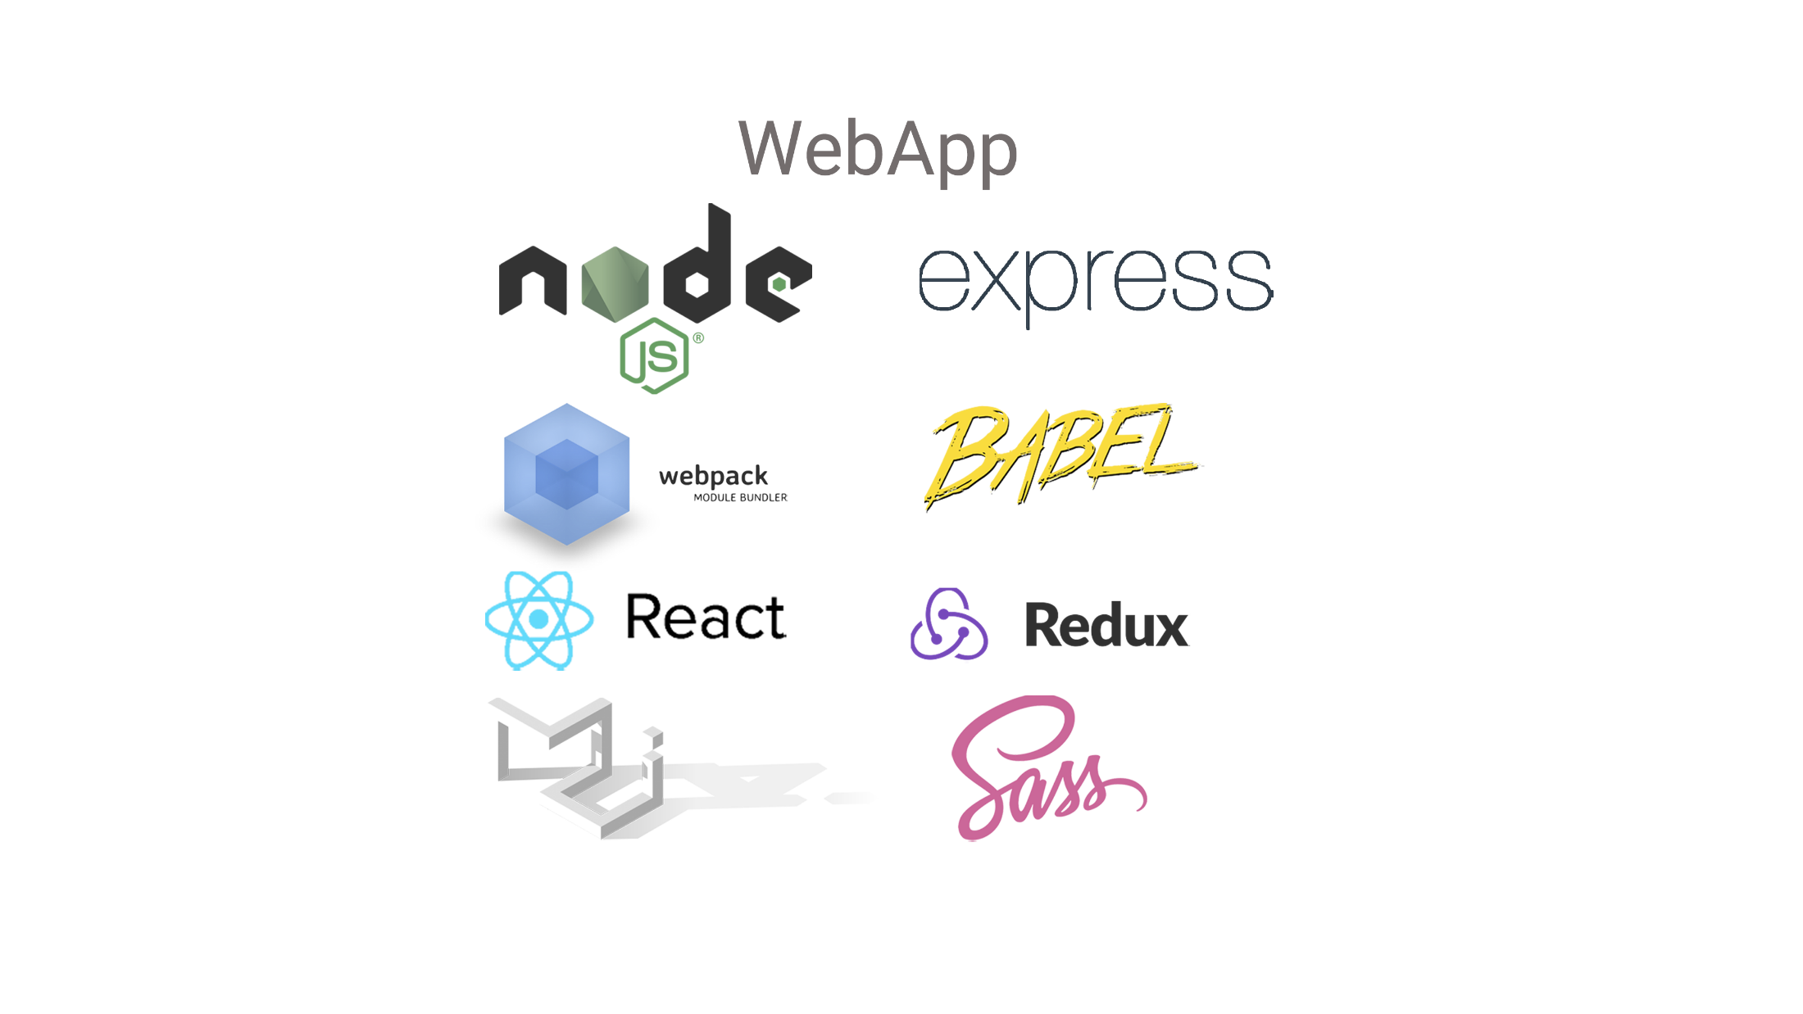

Slide 26
Future improvements

Slide 27
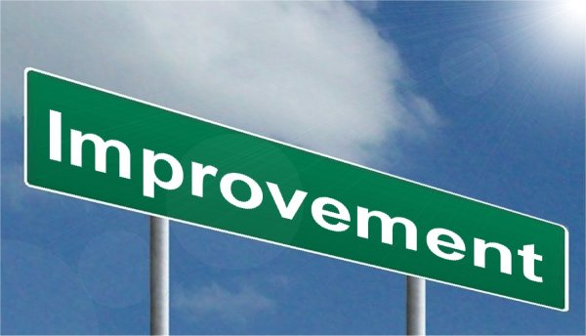

Slide 28
Chrome notifications
Item and dashboard sharing
OAuth logins with Facebook/Google
Real time updates with websockets
Admin menu

Slide 29
What we have learned

Slide 30
Work in a team
Task planning
Coding best practices
Test driven development
Design patterns
Create Windows service
Deploying to production server

Slide 31
@AdformTech

